Slide 1
Digital Image Formats
An Introduction
Dr. Umberto Michelucci
umberto.michelucci@hslu.ch

Slide 2
Raster and Vector images
Raster Images
Image made of pixels
Resolution dependent (cannot be scaled up or down without loss of quality)
Vector Images
Made of lines and curves drawn with mathematical equations (Bezier curves for example, see https://pomax.github.io/bezierinfo/)
Not resolution related
Can be resized without loss of quality
In Deep Learning we work with Raster images.

Slide 3
Vector images in Deep Learning Research
Vector images are not used to train deep learning models but…
They should be used in publications as they can be scaled and appear very sharp when published on papers or posters (typically in A0 format).
Matplotlib can easily export in vector formats (EPS, PDF, etc.) any figure you generate (https://matplotlib.org/stable/api/_as_gen/matplotlib.pyplot.savefig.html).
Possible Formats: eps, jpeg, jpg, pdf, pgf, png, ps, raw, rgba, svg, svgz, tif, tiff (underline → vector format).

Slide 4
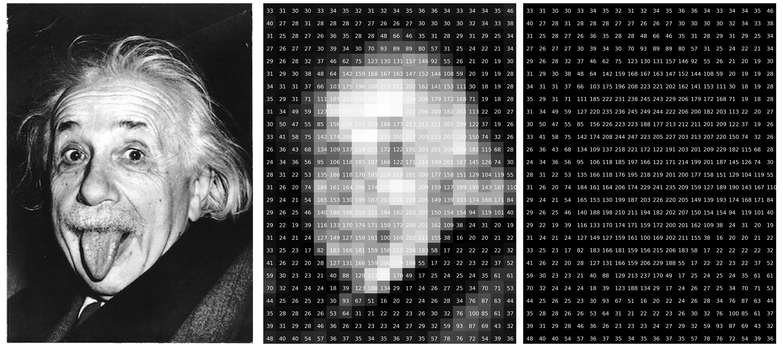
Raster image – an example

Slide 5
Image features
Resolution (relevant for quality)
Dot per inch (DPI) (relevant for printing)
Compression (relevant for storage and quality)
Transparency
Anti-aliasing
And many more.
For deep learning normally those features (except resolution) are irrelevant.

Slide 6
DPI: an explanation
Let’s suppose you want to print an image 3 in x 3 in (ca. 7.6 cm x 7.6 cm).
Let’s also suppose you want to print it with 300 dots for each horizonal in (300 DPI).
This means that you need a resolution of at least (or more of course) 900x900 pixels. DPI choice is also related to viewing distance.
Note: DPI is the number of printed dots within one inch (1″) of an image printed by a printer. PPI is the number of pixels within one inch (1″) of an image displayed on a computer monitor.

Slide 7
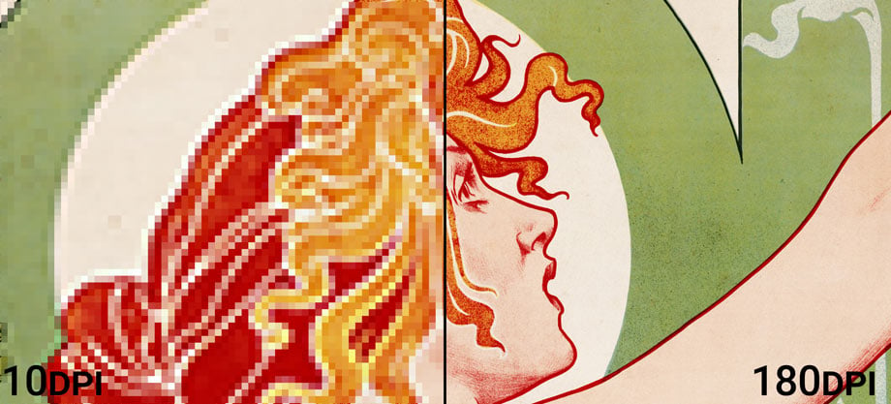
DPI: an explanation
https://prinfab.com/blog/viewing-distance-and-dpi/

Slide 8
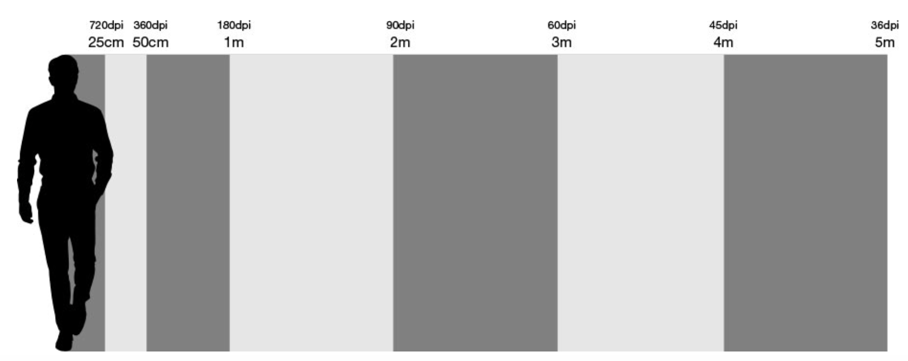
DPI: an explanation
The closer you are to a printed image, the higher you should choose the DPI.
https://prinfab.com/blog/viewing-distance-and-dpi/

Slide 9
Notable example: transparency and matplotlib
Transparency is not relevant for deep learning, but it can be used in matplotlib (https://matplotlib.org/).
To introduce transparency, an additional channel is introduced (alpha channel) transforming an image from RGB to RGBA.
In matplotlib you can use this channel by using the alpha option.
Example:
axes.plot(x,x**2, color='purple', alpha=0.1)
Note that not all image formats support transparency (for example EPS does not).
Transparency is not used in Deep Learning.

Slide 10
Characteristics of images
Image size (storage space)
Image resolution
Number of channels (1 for B&W, 3 for colors in RGB and 4 for CYMK, 4 with transparency)
Color Depth (number of bits to describe the color)
Compression (lossless or lossy)
Specific formats (way in which the information is stored digitally)

Slide 11
Lossless Formats
General Information
No information is lost in the process between acquisition and storage.
Typically lossless images are (very) large in size (especially with modern sensors)
Lossless Formats:
TIFF, PNG, BMP, RAW, GIF

Slide 12
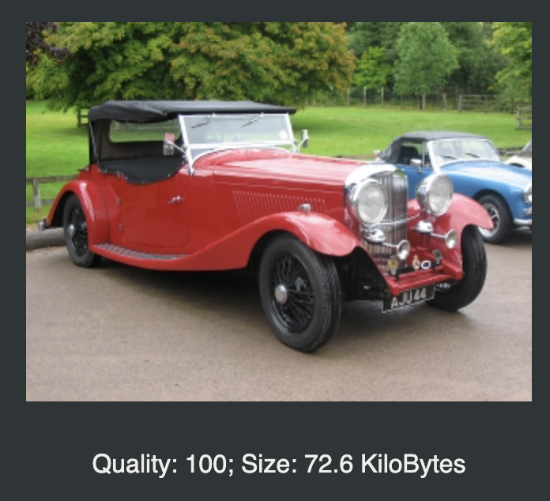
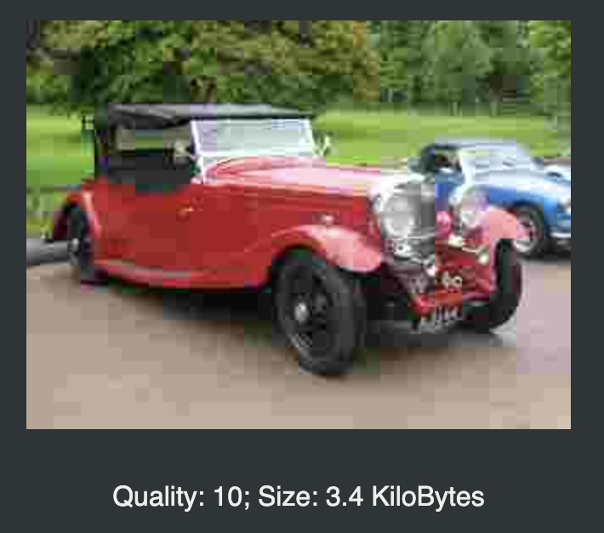
Non lossless compression
Non-lossless compression reduce the size of images, at the cost of loosing informations.
The original image cannot be recuperated from the compressed one.
Too much compression may introduce artifacts and reduce drastically image quality.
File formats examples: JPEG, GIF
https://docs.gimp.org/2.8/en/gimp-tutorial-quickie-jpeg.html

Slide 13
Lossy compression with Deep Learning
Curios fact: it is possible to do lossy compression thank to autoencoders.

Slide 14
TensorFlow compatible image formats
TensorFlow provides Ops to decode and encode JPEG and PNG formats. It results in a uint8 tensor of shape [height, width, channels]
GIF is understood but results in a uint8 tensor of shape [num_frames, height, width, 3]
You can do all typical operations on images with TF as crop, adjust hue, saturation, resize, etc.
→ This is relevant since the datatypes are all Tensors, thus the code is optimized and no convertions are needed.
https://www.tensorflow.org/api_docs/python/tf/image#:~:text=TensorFlow%20provides%20Ops%20to%20decode,(PNG%20also%20supports%20uint16.)

Slide 15
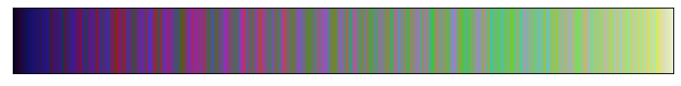
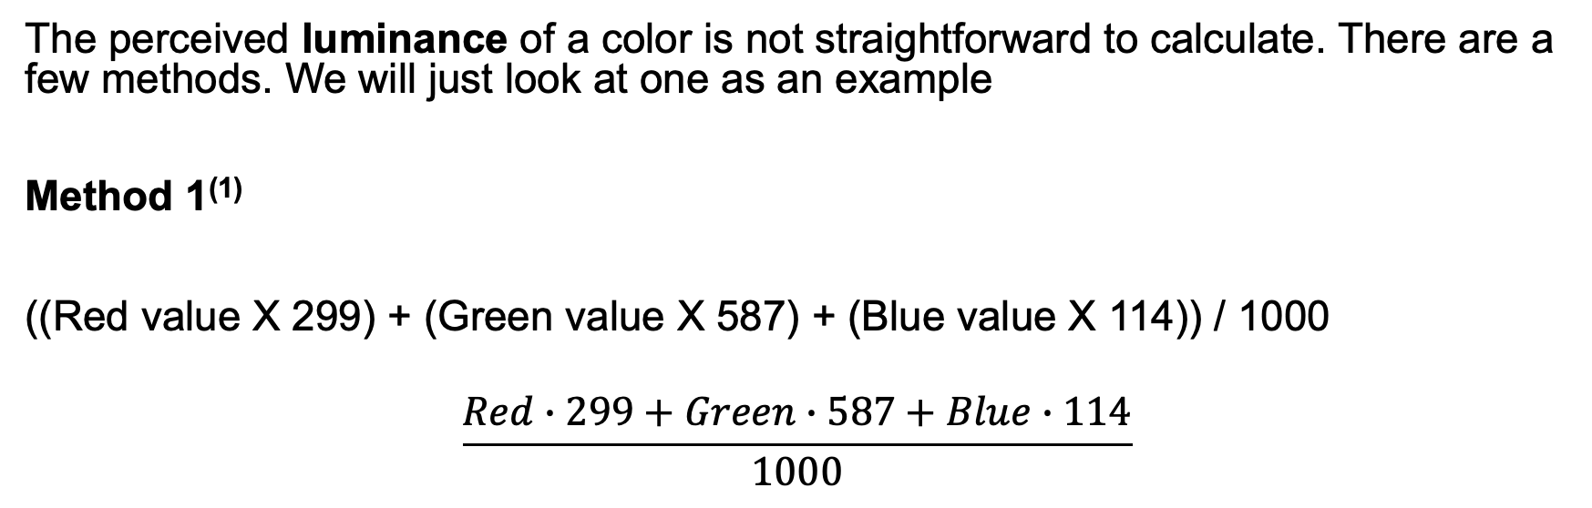
A detour: luminance and colors
The perceived luminance of a color is not straightforward to calculate. There are a few methods. We will just look at one as an example
Method 1⁽¹⁾
((Red value X 299) + (Green value X 587) + (Blue value X 114)) / 1000
$$\frac{Red∙299+Green∙587+Blue∙114}{1000}$$
⁽¹⁾This algorithm is taken from a formula for converting RGB values to YIQ values. This brightness value gives a perceived brightness for a color. Source: https://www.w3.org/TR/AERT/#color-contrast

Slide 16

A detour: luminance and colors
We can create a new image by using the luminance as the only channel (thus, reducing to a B&W image) and plot it again.
The image below is the same as the previous one, with just one channel equal to the luminance calculated with the previous formula.
⁽¹⁾This algorithm is taken from a formula for converting RGB values to YIQ values. This brightness value gives a perceived brightness for a color. Source: https://www.w3.org/TR/AERT/#color-contrast

Slide 17
Colors and Resolution in Deep Learning: some notes
Colors may contain information and thus increase deep learning model performance.
This is not always obvious and needs to be tested.
The optimal resolution needs also to be tested. Large resolution will lead to very slow training.
Almost all pre-trained models expected specific resolution, so resizing is often needed.

Slide 18
Code Discussion

Slide 19
Python libraries for image processing
Pillow/PIL - https://pillow.readthedocs.io/en/stable/
openCV - https://opencv.org/
Scikit-Image - https://scikit-image.org/
Scipy (it does offer some machine learning algorithms, as face detection) - https://scipy.org/
Mahotas - https://mahotas.readthedocs.io/en/latest/
TensorFlow - https://www.tensorflow.org/api_docs/python/tf/image

